Slide 1
C-C Cross-Coupling Reactions

Slide 2
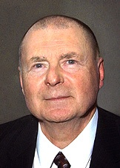
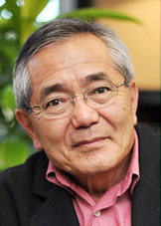
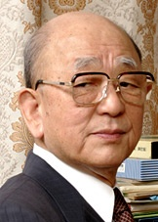
Honor
Richard F. Heck
Ei-ichi Negishi
Akira Suzuki
In 2010, they were jointly awarded Nobel prize in Chemistry

Slide 3

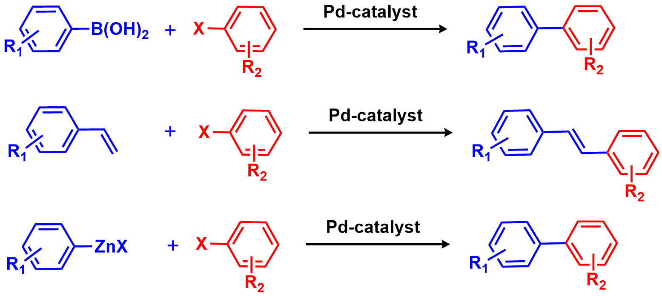
Chemistry Nobel Prize 2010: C-C Coupling Catalysis
Akira Suzuki
Richard F. Heck
Ei-ichi Negishi

Slide 4
Various coupling reactions
Cross-coupling is broadly recognized as a reaction in which two different fragments are connected by a single bond.

Slide 5
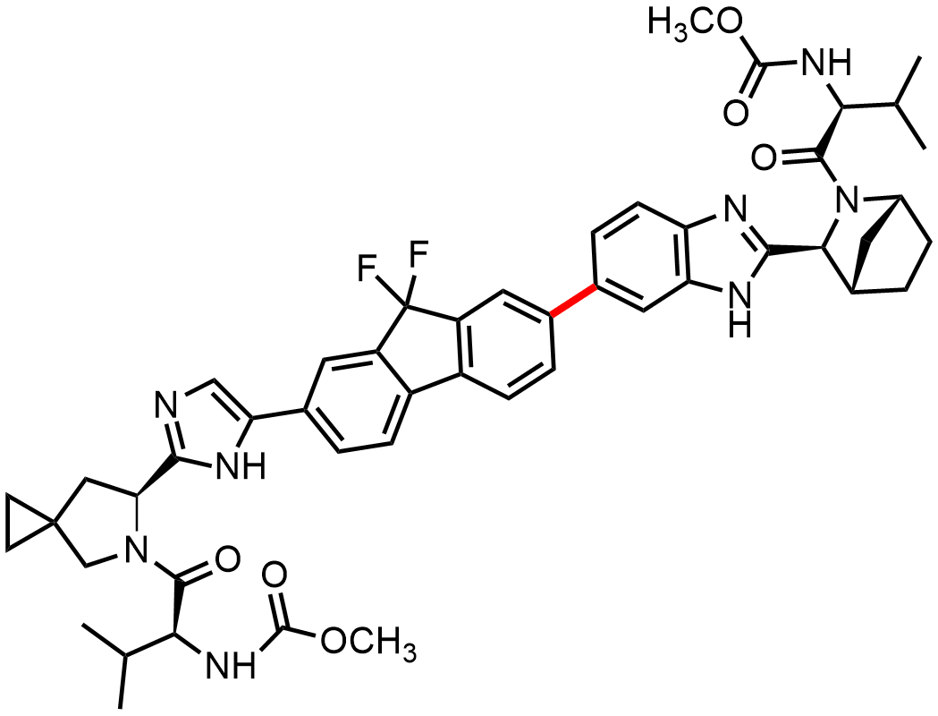
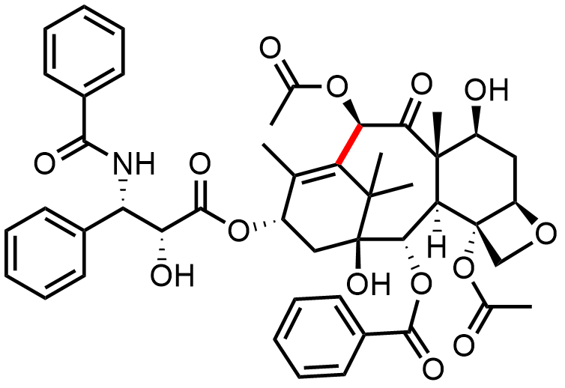
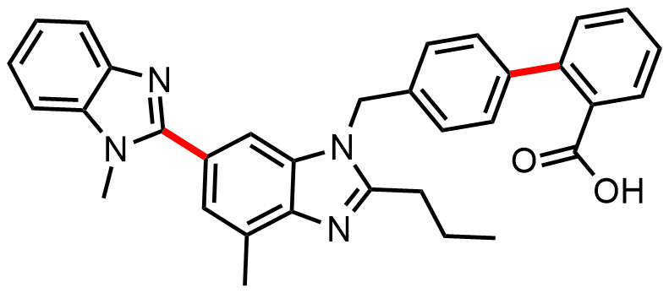
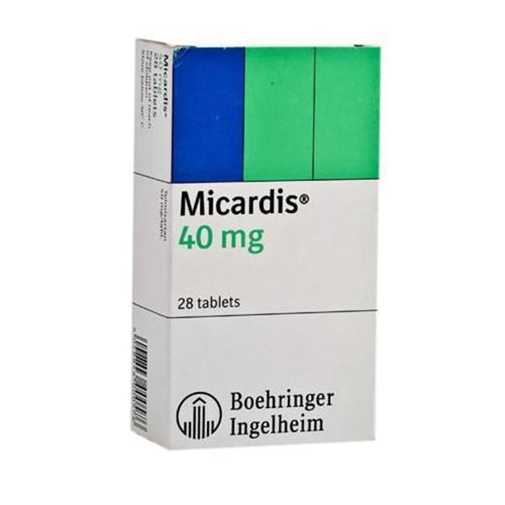
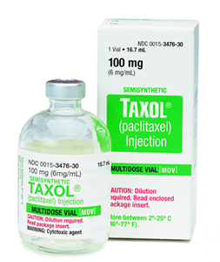
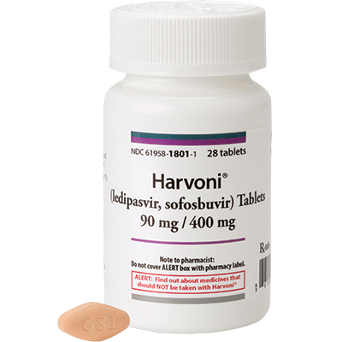
10000 Crore- 100000 Crore Rs Molecules:
Telmisartan (Micardis®)
Paclitaxel (Taxol)
Ledipasvir/sofosbuvir (Harvoni)
Anti hypertensive drug
Marketed by: Boehringer Ingelheim (Germany)
Used to treat hepatitis C
Marketed by: Gilead Sciences
2nd most top selling drug
TON per year: 10,16,78,57,60,000.00 INR
Anti cancer drug
Marketed by: Bristol-Myers Squibb

Slide 6
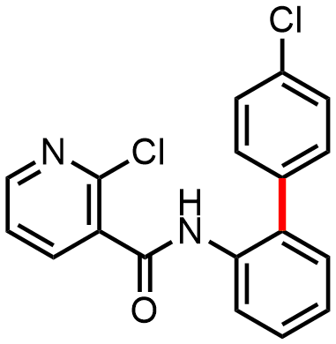
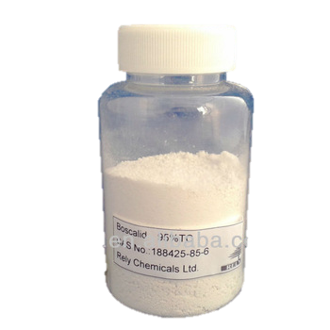
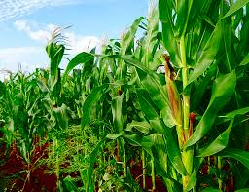

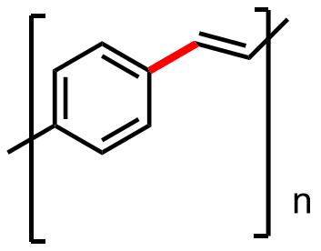
Boscalid
Fungicide
Marketed by: BASF (Germany)
OLED : Poly(p-phenylene vinylene) (PPV)

Slide 7
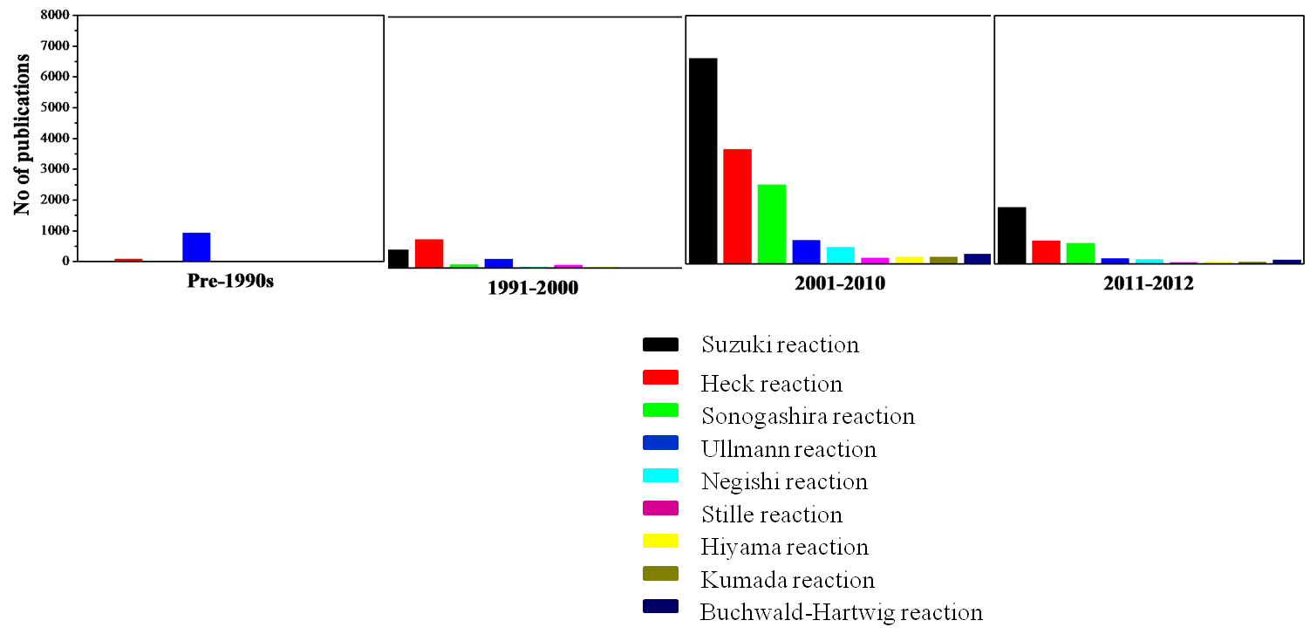
Growth in the number of publications and patents
Scifinder

Slide 8
Suzuki Coupling
When X= Br or I the reaction is more facile than when X= Cl
Most of the substrates in Suzuki coupling are used as bromides or iodides
Activation of chloride substrates specially at room temperature remains one of the most challenging jobs in Suzuki coupling.

Slide 9
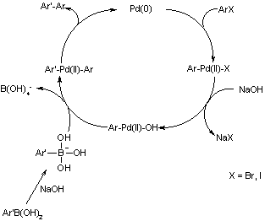

Slide 10
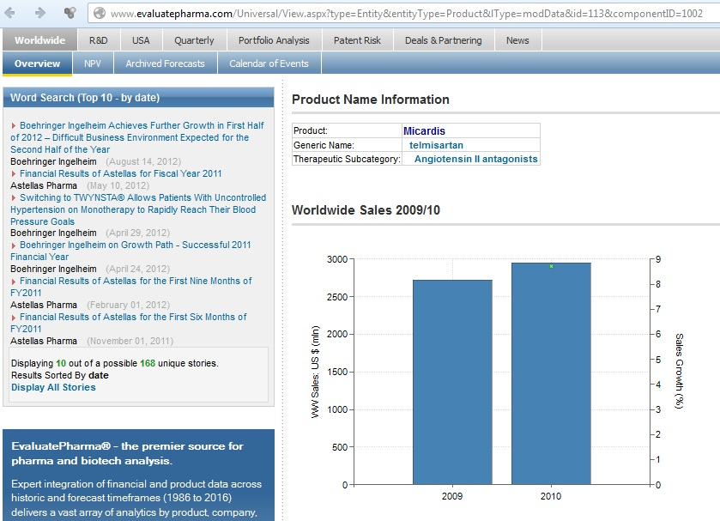
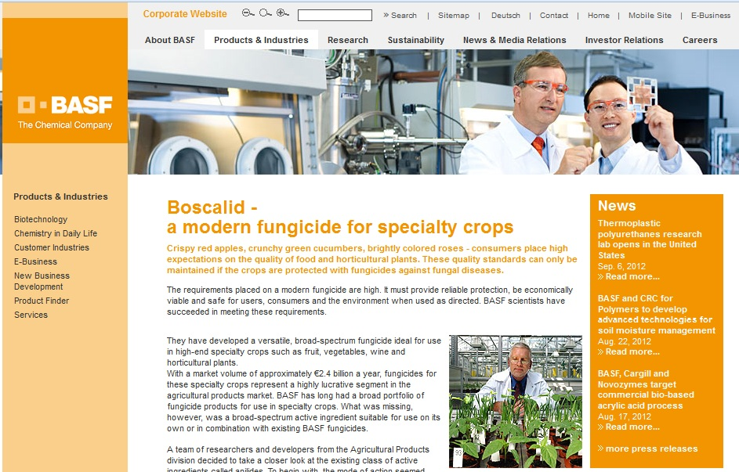
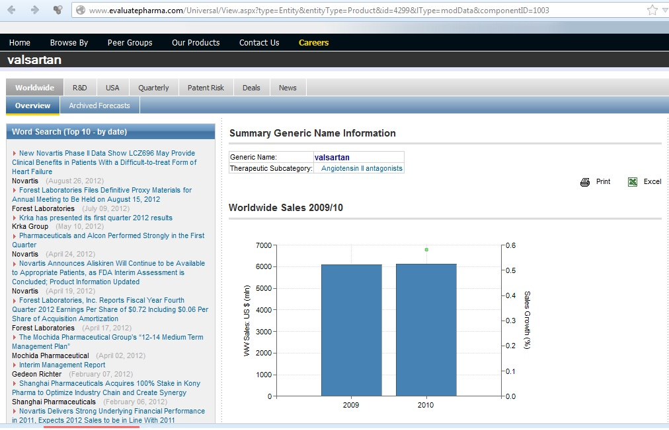
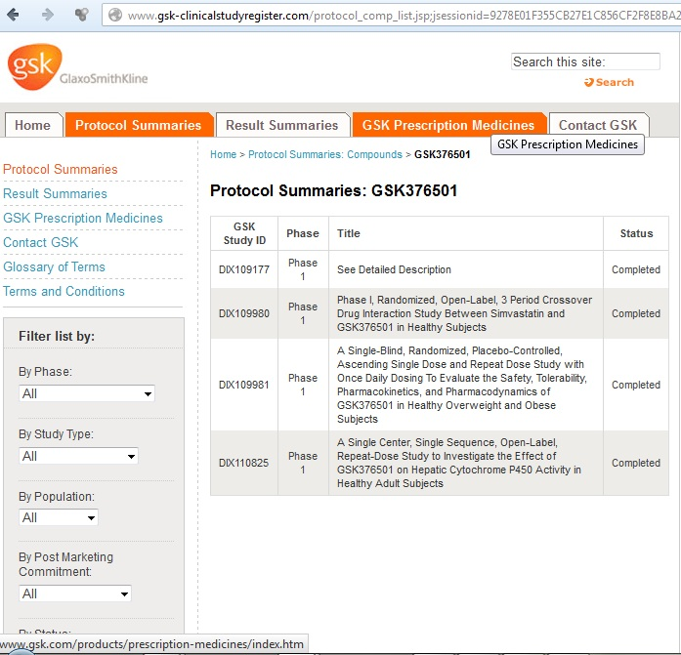
Suzuki coupling and drugs
Boscalid (BASF): € 2.4 billion/year
Telmisartan/Micardis (Boehringer Ingelheim): $ 3 billion/year
Valsartan/Diovan (Novartis): $ 6 billion/year

Slide 11
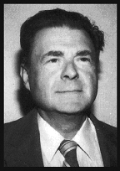
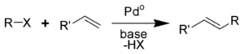
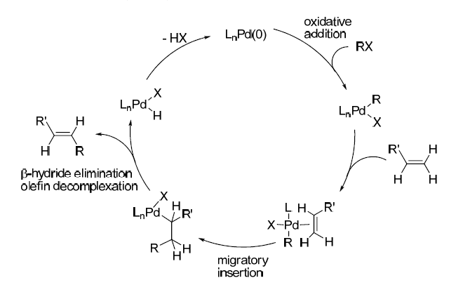
Heck Reaction

Slide 12
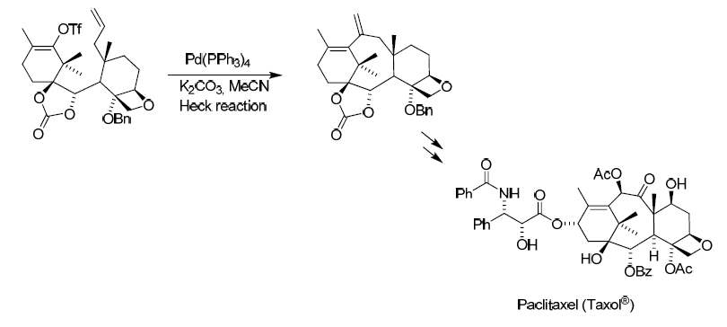
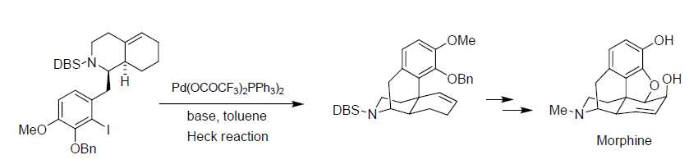
Application of Heck Reaction
Anti-cancer
Analgesic

Slide 13
The Heck Reaction: Estrone
estrogenic hormone
L. F. Tietze, T. NVbel, M. Spescha, J. Am. Chem. Soc. 1998, 120, 8971 – 8977.

Slide 14
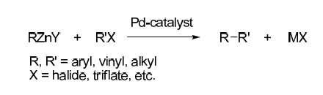
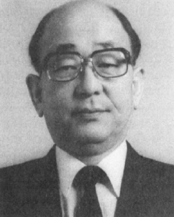
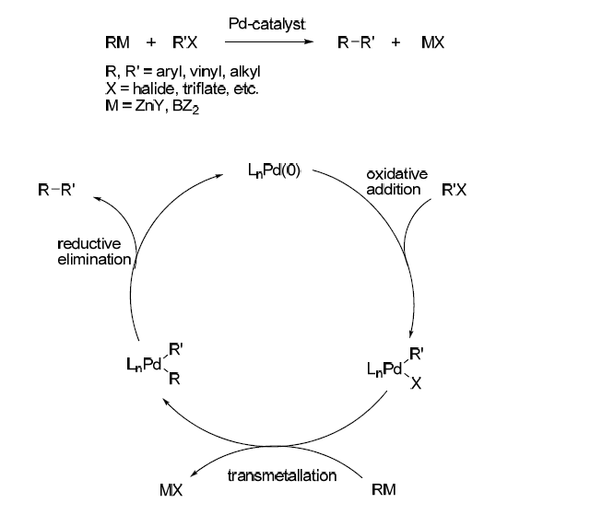
Negishi Reaction

Slide 15
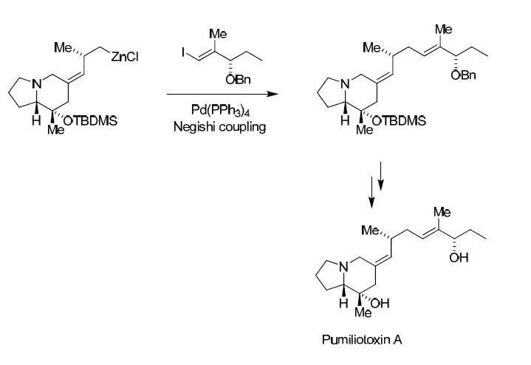
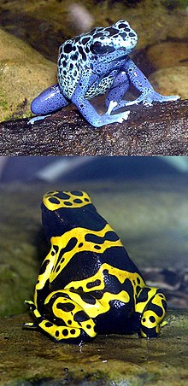
Application of Negishi Reaction

Slide 16
Application of Negishi Reaction
estrogenic hormone
a) A. B. Smith III, T. J. Beauchamp, M. J. LaMarche, M. D. Kaufman, Y. Qiu, H. Arimoto, D. R. Jones, K. Kobayashi, J. Am. Chem. Soc. 2000, 122, 8654 – 8664;
b) A. B. Smith III, M. D. Kaufman, T. J. Beauchamp,M. J. LaMarche, H. Arimoto, Org. Lett. 1999, 1, 1823 – 1826.
c) For a review of the chemistry and biology of discodermolide, see: M. Kalesse, ChemBioChem 2000, 1, 171 – 175
d) For examples of other approaches to discodermolide, see: I. Paterson, G. J. Florence, Eur. J. Org. Chem. 2003, 2193 – 2208.
e) In the synthesis of discodermolide by the Marshall group, a B-alkyl Suzuki–Miyarua fragment-coupling strategy was employed to form the C14C15 bond, in which 2.2 equivalents of an alkyl iodide structurally related to 309 was required: J. A. Marshall, B. A. Johns, J. Org. Chem. 1998, 63, 7885 – 7892.

Slide 17
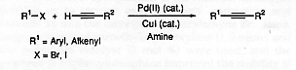
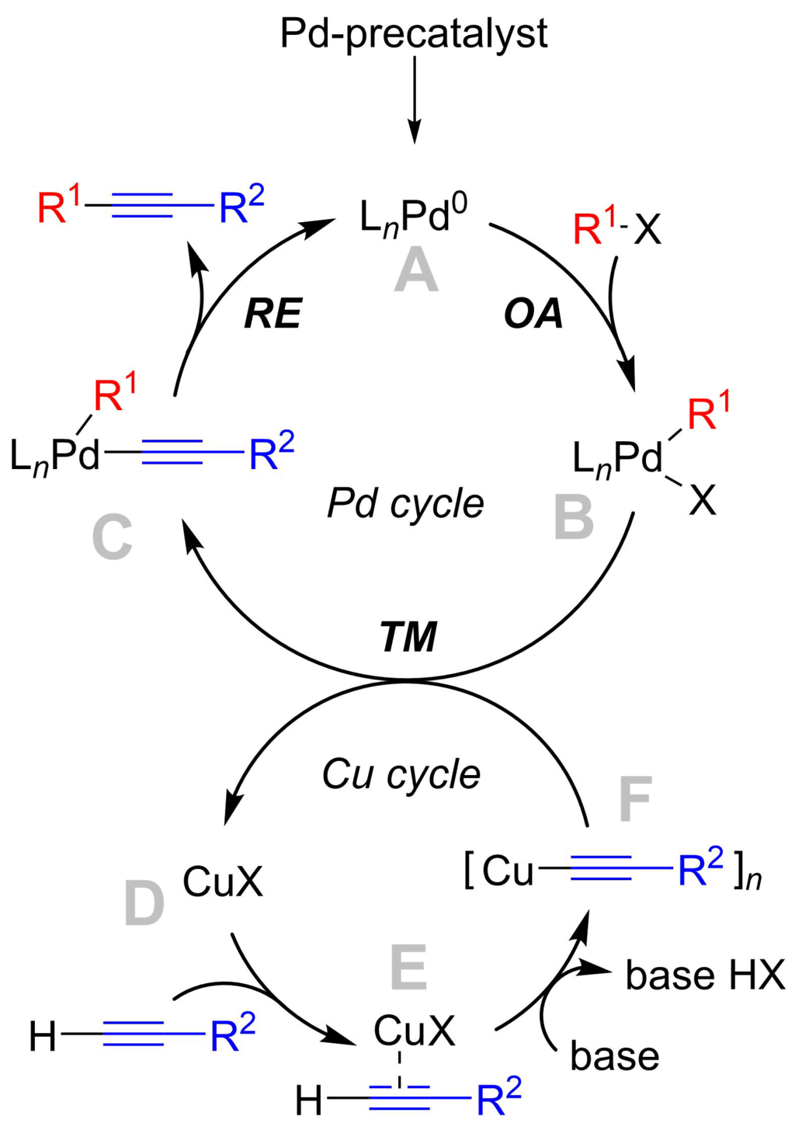
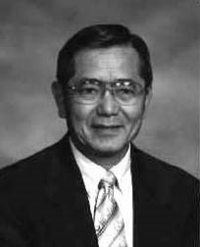
Sonogashira Reaction

Slide 18
The Sonogashira Coupling: Eicosanoid 212
anti inflammation
K. C. Nicolaou, S. E. Webber, J. Am. Chem. Soc. 1984, 106, 5734 – 5736

Slide 19
The Sonogashira Coupling: Disorazole C₁
217
anti cancer
P. Wipf, T. H. Graham, J. Am. Chem. Soc. 2004, 126, 15346 –15347.

Slide 20
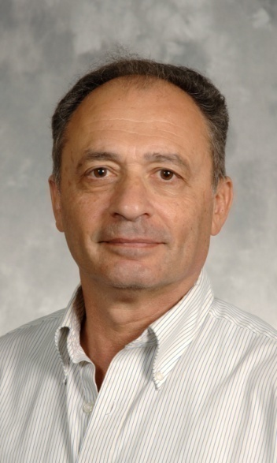
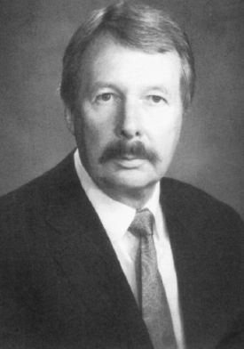
Stille Reaction
a) D. Milstein, J. K. Stille, J. Am. Chem. Soc. 1978, 100, 3636 – 3638; b) D. Milstein, J. K. Stille, J. Am. Chem. Soc. 1979, 101, 4992 – 4998.

Slide 21
The Stille Coupling: Rapamycin
immunosuppressant drug
a) K. C. Nicolaou, T. K. Chakraborty, A. D. Piscopio, N. Minowa, P. Bertinato, J. Am. Chem. Soc. 1993, 115, 4419 – 4420; K. C. Nicolaou, A. D. Piscopio, P. Bertinato, T. K. Chakraborty, , N. Minowa, K. Koide, Chem. Eur. J. 1995, 1, 318 –333.
b) A. B. Smith III, S. M. Condon, J. A. McCauley, J. L. Leazer, Jr.,J. W. Leahy, R. E. Maleczka, Jr., J. Am. Chem. Soc. 1995, 117, 5407 – 5408.

Slide 22
The Stille Coupling: Sanglifehrin
immunosuppressive natural product
a) K. C. Nicolaou, J. Xu, F. Murphy, S. Barluenga, O. Baudoin, H.-X.Wei, D. L. F. Gray, T. Ohshima, Angew. Chem. Int. Ed. 1999, 38, 2447 – 2451;
b) K. C. Nicolaou, F. Murphy, S. Barluenga, T. Ohshima, H. Wei, J. Xu, D. L. F. Gray, O. Baudoin, J. Am. Chem. Soc. 2000, 122, 3830 – 3838.

Slide 23
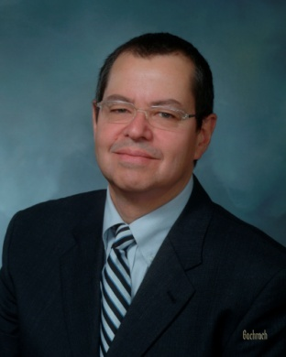
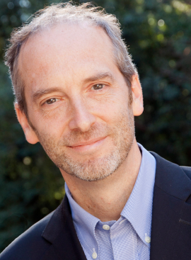
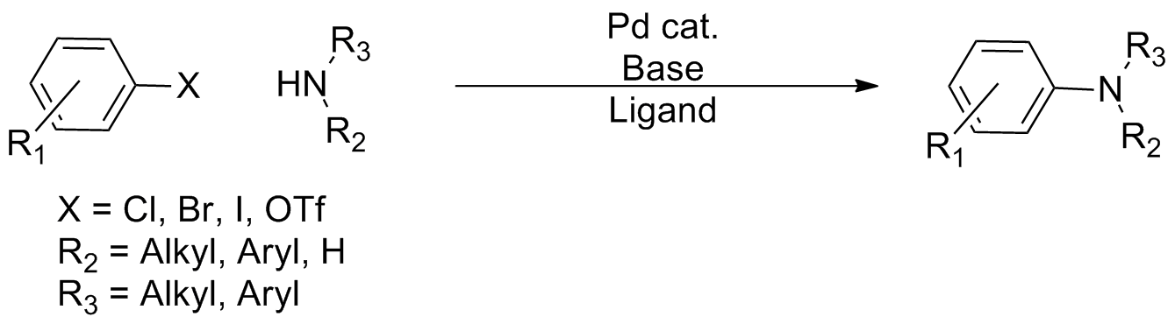
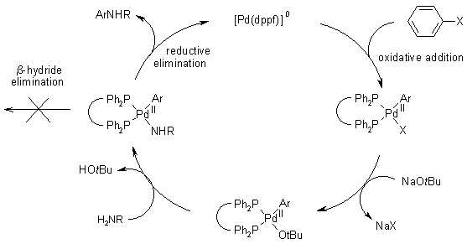
Buchwald-Hartwig Coupling

Slide 24
Buchwald-Hartwig Amination
Buchwald and co-workers, Angew. Chem., Int. Ed. Engl. 1995, 34, 1348−1350.
Hartwig and co-workers, Tetrahedron Lett. 1995, 36, 3609-3612
Imatinib (Gleevec)
Abilify
Schizophrenia and bipolar disorder
Celebrex
Nilotinib (Tasigna)

Slide 25
Cross-Coupling Reactions: Drawbacks and Modification

Slide 26
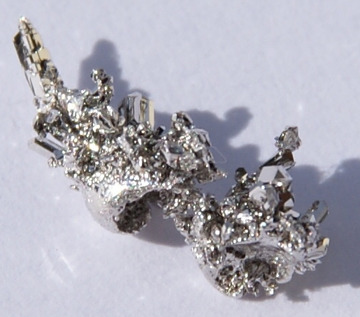
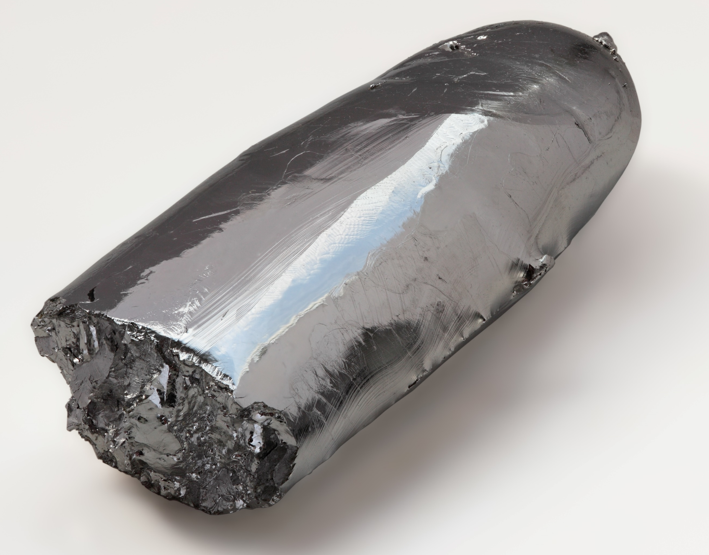
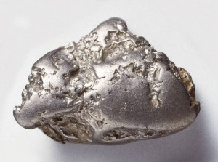
Limitations of Noble Metal Catalysts
Problems:
Very low abundance on earth’s crust
Expensive metals
Toxicity
Palladium
Metals | Abundance (ppm) | Price [USD (INR)/Kg)]
Gold | 0.004 | 43,764 (32,00,000)
Platinum | 0.005 | 1,48,787 (1,08,81,500)
Palladium | 0.015 | 32,205 (23,50,000)
Ruthenium | 0.001 | 8,423 (6,15,000)
Iridium | 0.001 | 46,940 (34,32,000)
Rhodium | 0.001 | 77,804 (56,88,000)
Ruthenium
Source: Anderson, D. L. ‘Chemical Composition of the Mantle’ in Theory of the Earth, pp. 147.
Rhodium
Alternative Approach:
Designing Catalysts with Earth Abundant 1st Row Transition Metals !

Slide 27

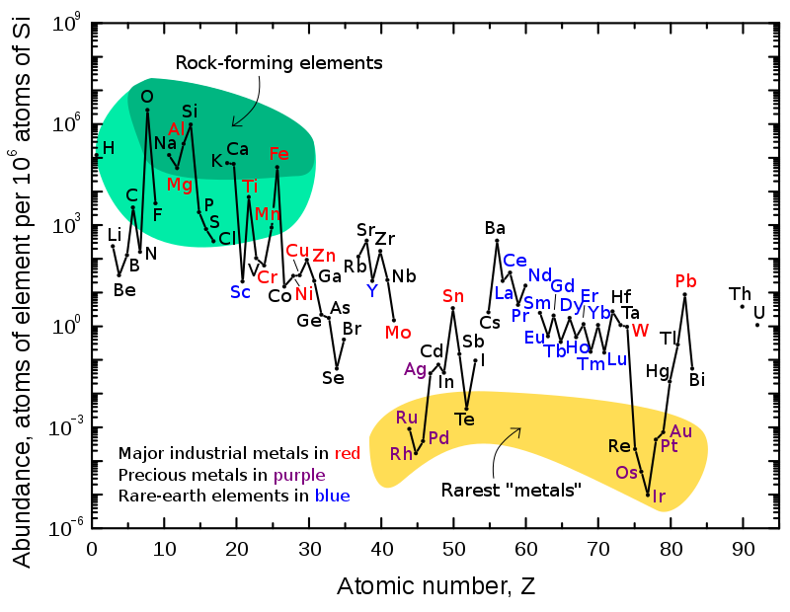
1st Row Transition Metals
High natural abundance on Earth’s crust
Easily available, cost effective and relatively non-toxic
Metals | Abundance (ppm) | Price [INR/Kg]
Iron | 63000 | 1
Titanium | 4,400 | 6098
Manganese | 1,100 | 590
Vanadium | 190 | 31,000
Chromium | 140 | 975
Nickel | 90 | 1300
Copper | 68 | 718
Cobalt | 30 | 6052
Source: Anderson, D. L. ‘Chemical Composition of the Mantle’ in Theory of the Earth, pp. 147.
Source: in.investing.com/commodities/metals

Slide 28
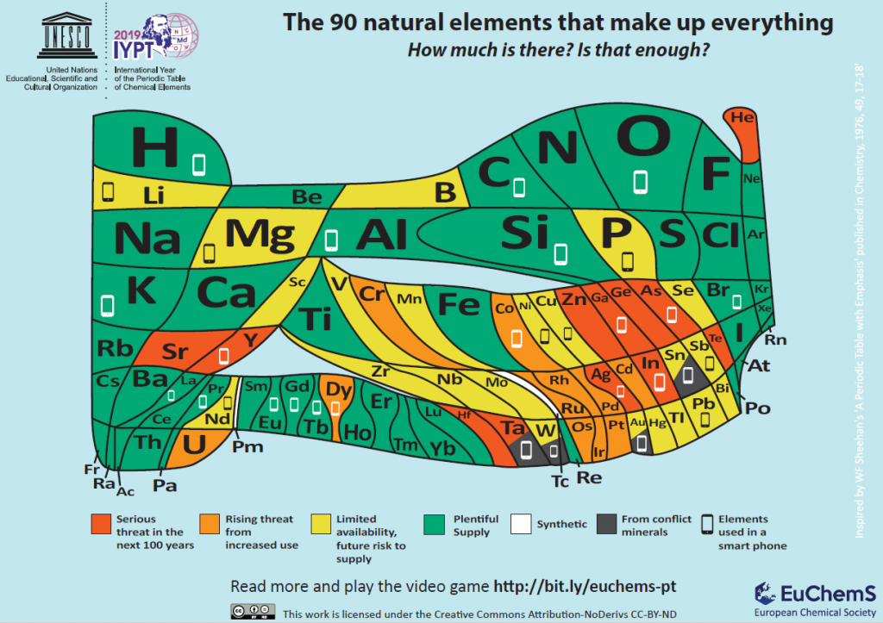

Slide 29
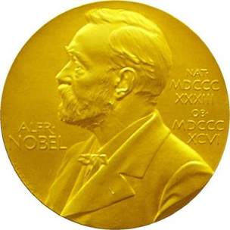
Metals and catalysis
Most Recent:
2005: Ru, Mo (orange elements, rising threat)
2010: Pd (orange elements, rising threat)
2021: Metal-free (small organic molecule)
Catalysis:
16 Nobel Prizes
Can small molecules show metal-like catalytic activity?

Slide 30
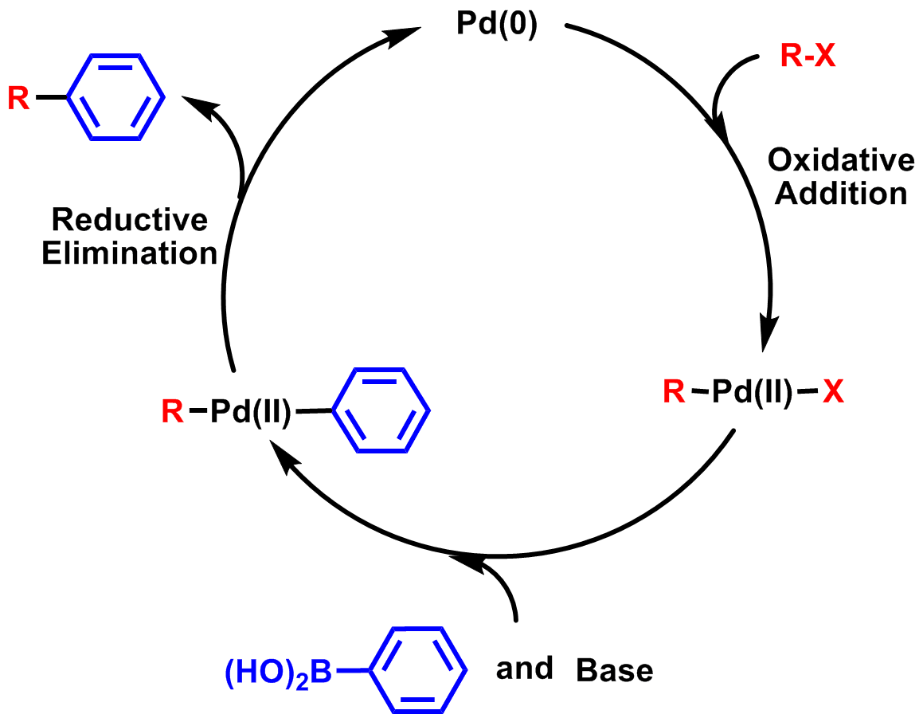
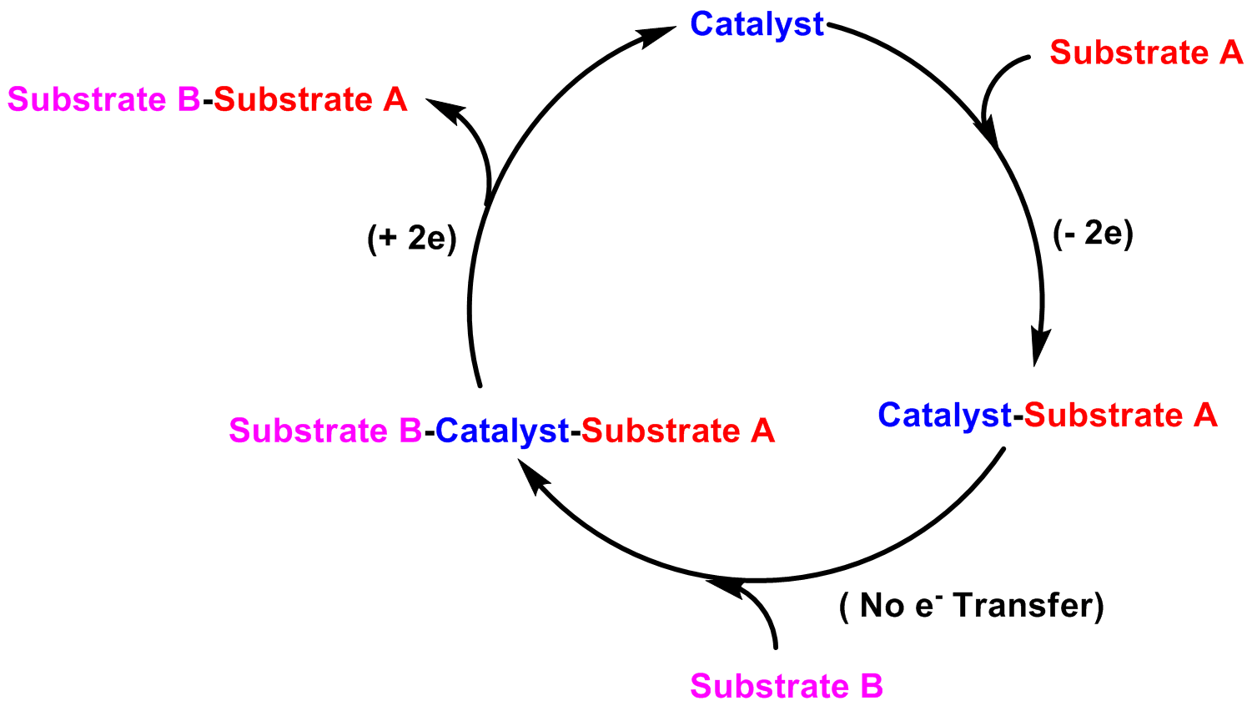
C-C cross-coupling without Pd/transition metal
Akira Suzuki
Richard F. Heck
Nobel Prize in Chemistry -2010
Ei-ichi Negishi
(2e)
Avoid external stimulation
Avoid Pd metal (0.015 ppm)

Slide 31
Aryl halide activation and cross-coupling reactions!

Slide 32
New Trends in Catalysis

Slide 33
How??
Catalyst Design Principle:
1. Lewis Acidity (mainly inorganic Lewis acids)
2. Redox Activity (mainly transition metals)
3. Lewis Basicity (mainly organic nucleophiles)

Slide 34
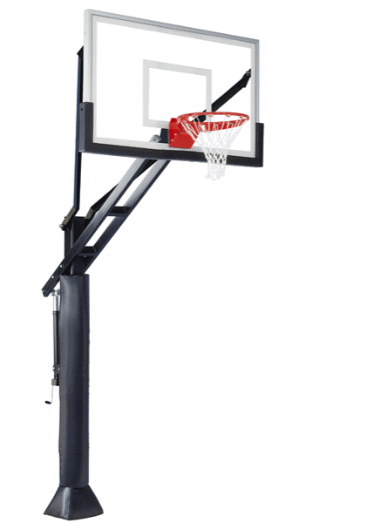
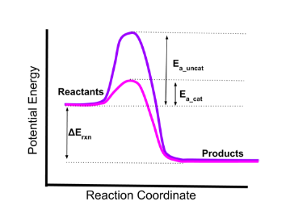

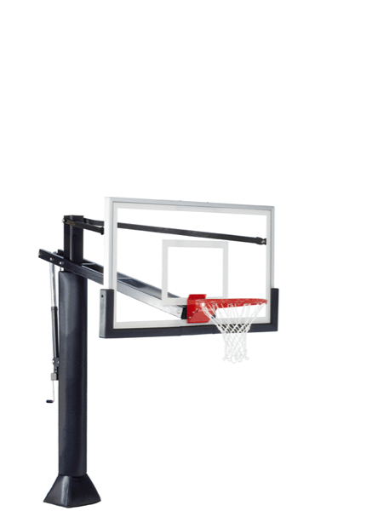


Catalyst Designing
Concept of catalysis:
Traditional method:

Slide 35




Merged Catalysis
Advanced approach:
Synergistic catalysis (Merged catalysis) !

Slide 36

Sustainable Catalysis
Sustainable Catalysis refers to the design and application of catalytic processes that are
Environmentally friendly
Economically viable
Socially responsible
Catalysis for a Sustainable Future
Challenges with Traditional Catalysis
Resource depletion
Harmful by-products
Inefficiencies and energy consumption

Slide 37


What is Sustainability?
Catalysis for a Sustainable Society
Meeting the needs of the present without compromising the ability of future generations to meet their own needs
-United Nations World Commission of Development and Environment
‘এ বিশ্বকে এ শিশুর বাসযোগ্য ক’রে যাব আমি নবজাতকের কাছে এ আমার দৃঢ় অঙ্গীকার’
Poet Sukanta Bhattachrayya
1926-1947, (From Charpatra)
"I will make this world habitable for this child,
This is my firm commitment to the newborn"

